Slide 1
How to Truly "Excel" at Data Analysis and Visualization: An Introduction to the R Programming Language
Daniel Herman
Patrick Mathias
Joseph Rudolf
December 13, 2020

Slide 2
Course Introduction

Slide 3
Course Goals
Gain familiarity with the R programming language and RStudio software
Learn some fundamentals of coding using Tidyverse tools on a clinical data set
Develop workflows for reproducible data analysis using RMarkdown

Slide 4
December 13 2020 | Session | Instructor
8:30 am - 8:50 am | Introduction to the Course | Daniel Herman Patrick Mathias Joseph Rudolf
9:00 am - 9:45 am | Introduction to R and RStudio | Joseph Rudolf
10:00 am - 10:45 am | Reproducible Reporting | Patrick Mathias
11:00 am - 11:00 am | Data Visualization | Joseph Rudolf
12:30 pm - 1:15 pm | Data Slicing | Patrick Mathias
1:30 pm - 2:15 pm | Data Transformation | Daniel Herman
2:30 pm - 3:15 pm | Statistical Analysis | Daniel Herman

Slide 5
Who are we?

Slide 6
Daniel Herman
Assistant Professor of Pathology and Laboratory Medicine
University of Pennsylvania Perelman School of Medicine
Director, Endocrinology Laboratory
Hospital of the University of Pennsylvania

Slide 7
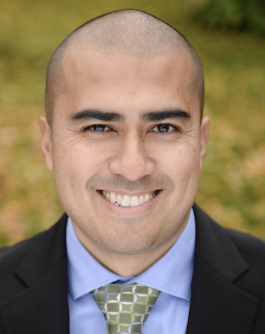
Patrick Mathias
Assistant Professor, Department of Laboratory Medicine
University of Washington School of Medicine
Associate Medical Director, Laboratory Medicine Informatics

Slide 8
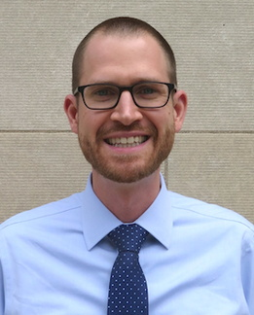
Joseph Rudolf
Assistant Professor, Department of Pathology, University of Utah Medical School
Medical Director, Automated Core Laboratory, ARUP Laboratories

Slide 9
Workshop Workflow

Slide 10
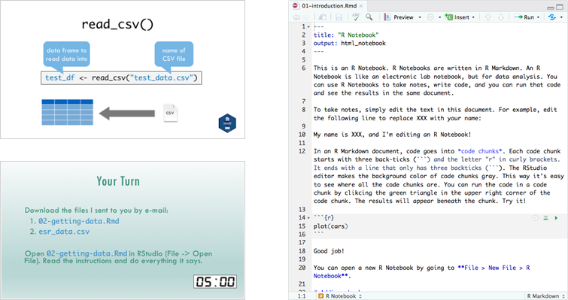
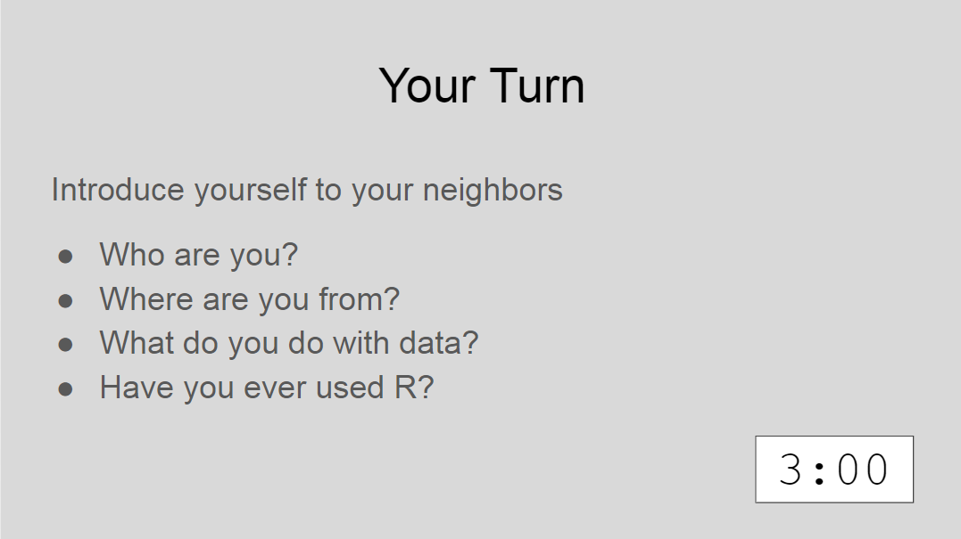
Sessions

Slide 11

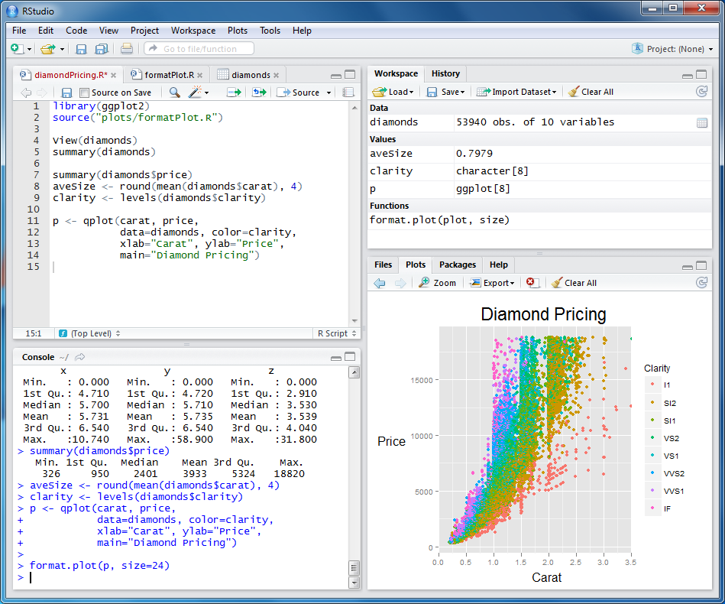



Configuring Your Setup
1
2

Slide 12
Workshop Coursebook
Print out of all slides
Appendix
Cheat Sheets
Useful resources

Slide 13
Using Zoom
Participants muted
Chat window
Non-verbal feedback

Slide 14
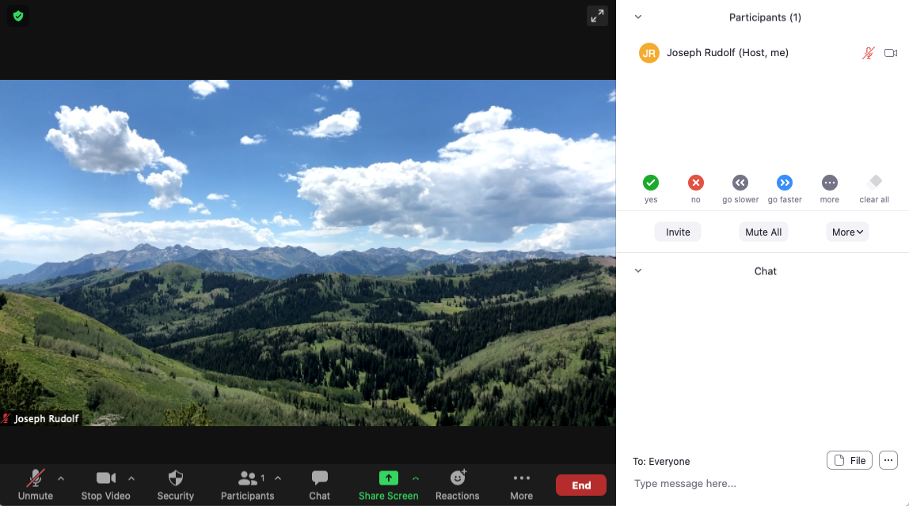

Slide 15
Getting Help
During presentation – Enter your question in the chat, an instructor will respond to the group our direct message you as appropriate.
Between sessions – Feel free to unmute yourself and converse with instructors.

Slide 16
Who are you?

Slide 17
Your Turn
Where are you today?
Type your name and location in the chat.

Slide 18
Pre-Course Survey Results

Slide 19
Time for the Course!!

